Slide 1
Java Applet
Instructor :Prashant Mishra
BIAS Bhimtal

Slide 2
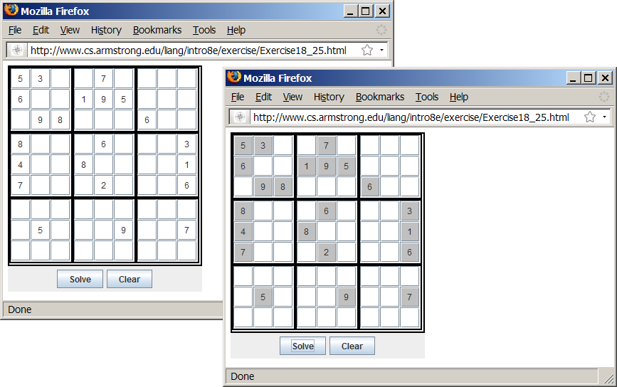
Motivations
When browsing the Web, you frequently see the graphical user interface and animation developed using Java. These programs are called Java applets. Suppose you want to develop a Java applet for the Sudoku game. How do you write this program?
Sudoku

Slide 3
java Applet
Applet is a special type of program that is embedded in the webpage to generate the dynamic content. It runs inside the browser and works at client side.
These are small applications that are accessed on an internet server, transported over the internet, automatically installed and run as part of a web document.

Slide 4
Advantage of Applet
There are many advantages of applet. They are as follows:
It works at client side so less response time.
Secured
It can be executed by browsers running under many platforms, including Linux, Windows, Mac Os etc.
Drawback of Applet
Plug-in is required at client browser to execute applet.

Slide 5
Important points :
All applets are sub-classes (either directly or indirectly) of java.applet.Applet class.
Applets are not stand-alone programs. Instead, they run within either a web browser or an applet viewer. JDK provides a standard applet viewer tool called applet viewer.
In general, execution of an applet does not begin at main() method.
Output of an applet window is not performed by System.out.println(). Rather it is handled with various AWT methods, such as drawString().

Slide 6
import javax.swing.*;
public class DisplayLabel extends JApplet {
public DisplayLabel() {
add(new JLabel("Great!", JLabel.CENTER));
}
}

Slide 7
DisplayLabel.html
<html>
<head>
<title>Java Applet Demo</title>
</head>
<body>
<applet
code = "DisplayLabel.class"
width = 250
height = 50>
</applet>
</body>
</html>

Slide 8
The HTML File and the <applet> Tag
To run an applet from a browser, you need to create an HTML file with the <applet> tag.
HTML is a markup language that presents static documents on the Web. It uses tags to
instruct the Web browser how to render a Web page and contains a tag called <applet> that
incorporates applets into a Web page.

Slide 9
Applications vs. Applets
Similarities
Since JFrame and JApplet both are subclasses of the Container class, all the user interface components, layout managers, and event-handling features are the same for both classes.
Differences
Applications are invoked from the static main method by the Java interpreter, and applets are run by the Web browser. The Web browser creates an instance of the applet using the applet’s no-arg constructor and controls and executes the applet through the init, start, stop, and destroy methods.
Applets have security restrictions
Web browser creates graphical environment for applets, GUI applications are placed in a frame.

Slide 10
Java Application | Java Applet
Java Applications are the stand-alone programs which can be executed independently | Java Applets are small Java programs which are designed to exist within HTML web document
Java Applications must have main() method for them to execute | Java Applets do not need main() for execution
Java Applications just needs the JRE | Java Applets cannot run independently and require API’s
Java Applications do not need to extend any class unless required | Java Applets must extend java.applet.Applet class
Java Applications can execute codes from the local system | Java Applets Applications cannot do so
Java Applications has access to all the resources available in your system | Java Applets has access only to the browser-specific services

Slide 11
Security Restrictions on Applets
Applets are not allowed to read from, or write to, the file system of the computer viewing the applets.
Applets are not allowed to run any programs on the browser’s computer.
Applets are not allowed to establish connections between the user’s computer and another computer except with the server where the applets are stored.

Slide 12
Conversions Between Applications and Applets
Conversions between applications and applets are simple and easy.
You can always convert an applet into an application.
You can convert an application to an applet as long as security restrictions are not violated.

Slide 13
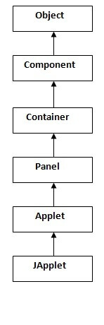
Hierarchy of Applet
As displayed in the diagram, Applet class extends Panel. Panel class extends Container which is the subclass of
Component.

Slide 14
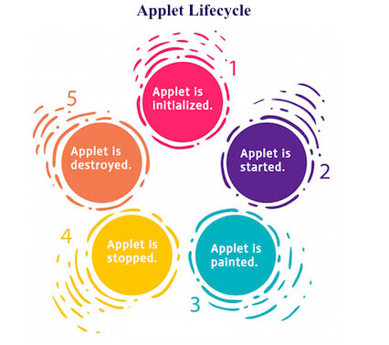
Lifecycle of Java Applet
Applet is initialized.
Applet is started.
Applet is painted.
Applet is stopped.
Applet is destroyed.

Slide 15
java.applet.Applet class
For creating any applet java.applet.Applet class must be inherited. It provides 4 life cycle methods of applet.
public void init(): This is the very first method to be invoked during the life cycle of an applet. In this method, the variable that will be used further in the applet is initialized. One thing you must note here is that this method can be invoked only once per applet life cycle.
public void start(): This is the second method that is invoked just after the init() method is called by the browser. Each time a user revisits the web page containing the applet, start() method is invoked and the applet is started.

Slide 16
public void stop(): This method is invoked whenever a user leaves the web page containing applet. In other words, the stop() method is used to suspend the threads which are not required when the applet is in the background or is not visible on the screen. These can be easily resumed using the start() method.
public void destroy(): Finally, we have the destroy() method which is invoked in order to completely remove an applet from the memory. This method is invoked only once per applet life cycle and all the engaged resources must be freed up before this method is called.

Slide 17
java.awt.Component class
The Component class provides 1 life cycle method of applet.
public void paint(Graphics g): is used to paint the Applet. It provides Graphics class object that can be used for drawing oval, rectangle, arc etc.

Slide 18
How to run an Applet?
There are two ways to run an applet
By html file.
By appletViewer tool (for testing purpose).

Slide 19
example of Applet by html file:
To execute the applet by html file, create an applet and compile it. After that create an html file and place the applet code in html file. Now click the html file.
//First.java
import java.applet.Applet;
import java.awt.Graphics;
public class First extends Applet{
public void paint(Graphics g){
g.drawString("welcome",150,150);
}
}
<html>
<body>
<applet code="First.class" width="300" height="300">
</applet>
</body>
</html>

Slide 20
example of Applet by appletviewer tool:
//First.java
import java.applet.Applet;
import java.awt.Graphics;
public class First extends Applet{
public void paint(Graphics g){
g.drawString("welcome to applet",150,150);
}
}
/*
<applet code="First.class" width="300" height="300">
</applet>
*/
to execute the applet by appletviewer tool,
write in command prompt:
c:\>javac First.java
c:\>appletviewer First.java

Slide 21
JApplet class in Applet
As we prefer Swing to AWT. Now we can use JApplet that can have all the controls of swing. The JApplet class extends the Applet class.

Slide 22
Applet Life-Cycle Methods
Applets are actually run from the applet container, which is a plug-in of a Web browser. The
Applet class contains the init(), start(), stop(), and destroy() methods, known as the life-cycle methods. These methods are called by the applet container to control the execution of an applet. They are implemented with an empty body in the Applet class. So, they do nothing by default. You may override them in a subclass of Applet to perform desired operations.
Figure 18.6 shows how the applet container calls these methods.

Slide 23
The Applet Class
When the applet is loaded, the Web browser creates an instance of the applet by invoking the applet’s no-arg constructor. The browser uses the init, start, stop, and destroy methods to control the applet. By default, these methods do nothing. To perform specific functions, they need to be modified in the user's applet so that the browser can call your code properly.

Slide 24
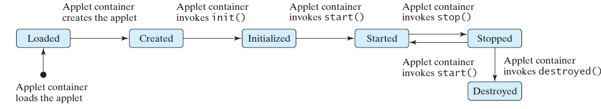
Browser Calling Applet Methods

Slide 25
The init() Method
Invoked when the applet is first loaded and again if the applet is reloaded.
A subclass of Applet should override this method if the subclass has an initialization to perform. The functions usually implemented in this method include creating new threads, loading images, setting up user-interface components, and getting string parameter values from the <applet> tag in the HTML page.

Slide 26
The start() Method
Invoked after the init() method is executed; also called whenever the applet becomes active again after a period of inactivity (for example, when the user returns to the page containing the applet after surfing other Web pages).
A subclass of Applet overrides this method if it has any operation that needs to be performed whenever the Web page containing the applet is visited. An applet with animation, for example, might use the start method to resume animation.

Slide 27
The stop() Method
The opposite of the start() method, which is called when the user moves back to the page containing the applet; the stop() method is invoked when the user moves off the page.
A subclass of Applet overrides this method if it has any operation that needs to be performed each time the Web page containing the applet is no longer visible. When the user leaves the page, any threads the applet has started but not completed will continue to run. You should override the stop method to suspend the running threads so that the applet does not take up system resources when it is inactive.

Slide 28
The destroy() Method
Invoked when the browser exits normally to inform the applet that it is no longer needed and that it should release any resources it has allocated.
A subclass of Applet overrides this method if it has any operation that needs to be performed before it is destroyed. Usually, you won't need to override this method unless you wish to release specific resources, such as threads that the applet created.

Slide 29
Writing Applets
Always extends the JApplet class, which is a subclass of Applet for Swing components.
Override init(), start(), stop(), and destroy() if necessary. By default, these methods are empty.
Add your own methods and data if necessary.
Applets are always embedded in an HTML page.

